Slide 1




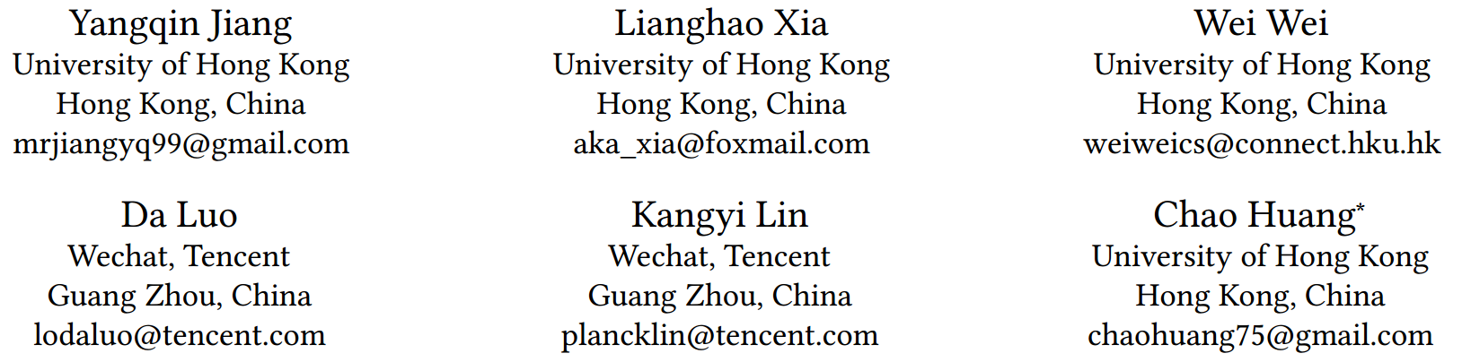



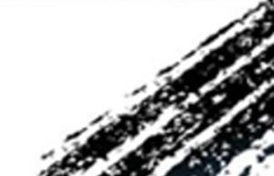

ATAI
Advanced Techniqueof Artificial Intelligence
ATAI
ChongqingUniversity _{AdvancedTechniqueof}
of Technology Artificial Intelligence
Chongqing University of
Technology
Chongqing University ^{ATAI}
_{of Technology} Advanced Techniqueof
Artificial Intelligence
Chongqing University of Technology
Chongqing University of Technology
DiffMM: Multi-Modal Diffusion Model for Recommendation
Code: https://github.com/HKUDS/DiffMM
2024.10.10•ChongQing
—— MM 2024
Reported by Lele Ren
1

Slide 2

ATAI
AdvancedTechniqueof
Artificial Intelligence
ATAI
ChongqingUniversity _{AdvancedTechniqueof}
of Technology Artificial Intelligence
ChongqingUniversity of Technology
Motivation
To address the challenge of data sparsity in recommender systems. Recent studies have introduced self-supervised learning techniques to enhance recommender systems. However, these methods usually rely on simple random augmentation or intuitive cross-view information, which introduces irrelevant noise and fails to accurately combine multimodal context with user-item interaction modeling. To fill this gap, we propose a novel multi-modal graph diffusion recommendation model, called DiffMM.

Slide 3

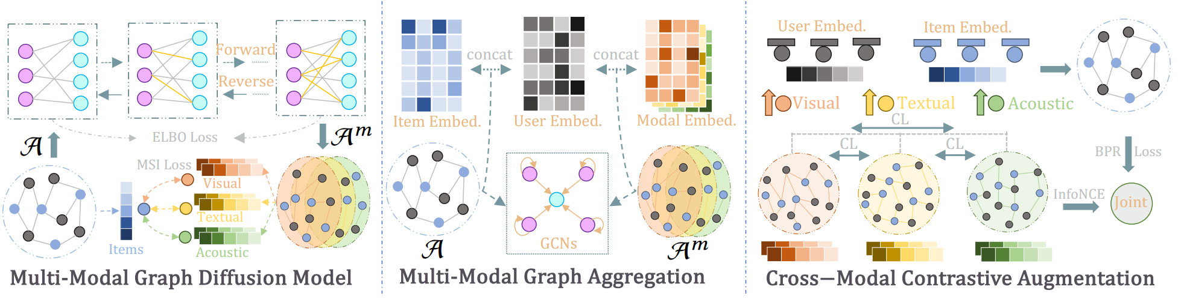
ChongqingUniversity of Technology
ATAI
AdvancedTechniqueof
Artificial Intelligence
ATAI
ChongqingUniversity _{AdvancedTechniqueof}
of Technology Artificial Intelligence
Overview

Slide 4

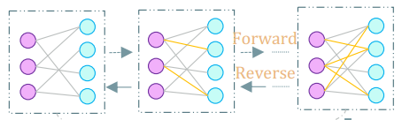
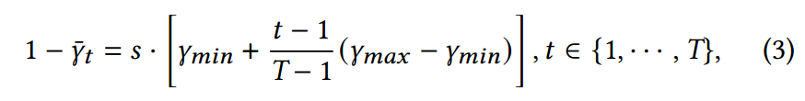
ChongqingUniversity of Technology
ATAI
AdvancedTechniqueof
Artificial Intelligence
ATAI
ChongqingUniversity _{AdvancedTechniqueof}
of Technology Artificial Intelligence
Method

Slide 5
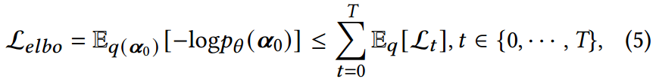
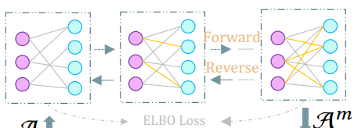
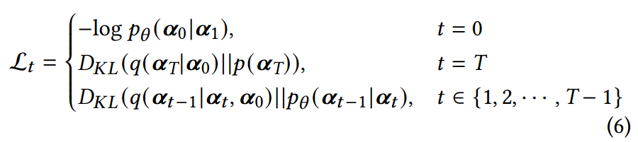
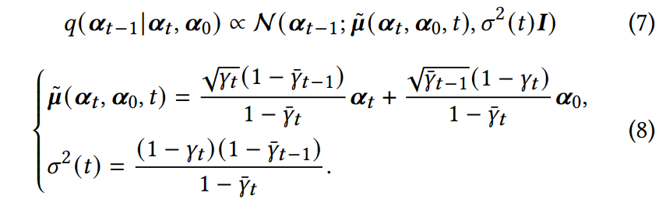
ChongqingUniversity of Technology
ATAI
AdvancedTechniqueof
Artificial Intelligence
ATAI
ChongqingUniversity _{AdvancedTechniqueof}
of Technology Artificial Intelligence
Method

Slide 6
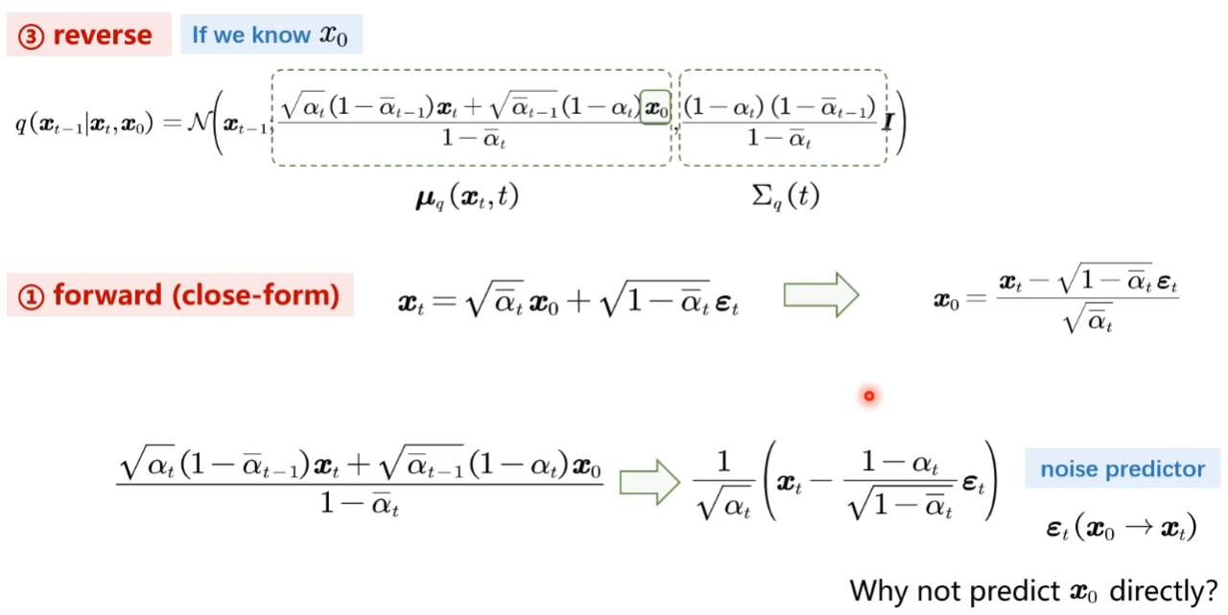
ChongqingUniversity of Technology
ATAI
AdvancedTechniqueof
Artificial Intelligence
ATAI
ChongqingUniversity _{AdvancedTechniqueof}
of Technology Artificial Intelligence
Method

Slide 7

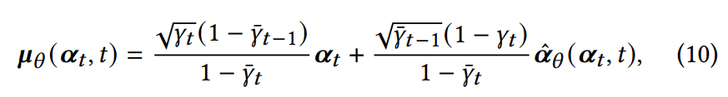
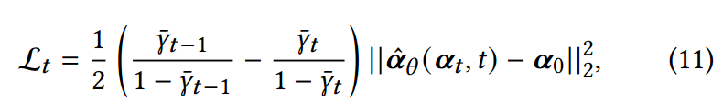

ChongqingUniversity of Technology
ATAI
AdvancedTechniqueof
Artificial Intelligence
ATAI
ChongqingUniversity _{AdvancedTechniqueof}
of Technology Artificial Intelligence
Method

Slide 8
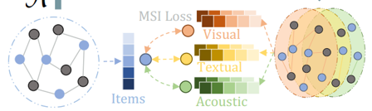
ChongqingUniversity of Technology
ATAI
AdvancedTechniqueof
Artificial Intelligence
ATAI
ChongqingUniversity _{AdvancedTechniqueof}
of Technology Artificial Intelligence
Method

Slide 9
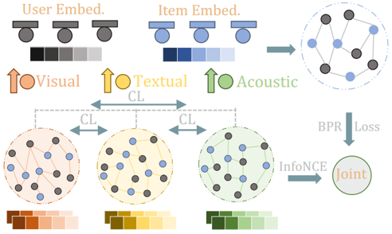
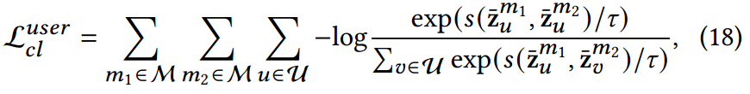
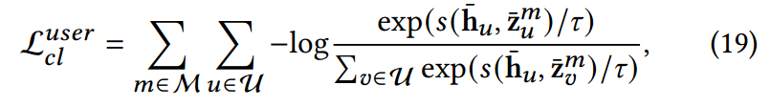
ChongqingUniversity of Technology
ATAI
AdvancedTechniqueof
Artificial Intelligence
ATAI
ChongqingUniversity _{AdvancedTechniqueof}
of Technology Artificial Intelligence
Method

Slide 10
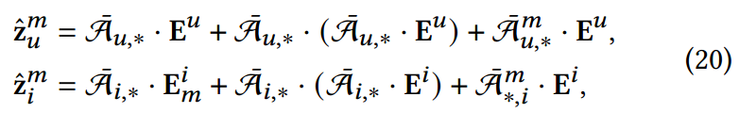
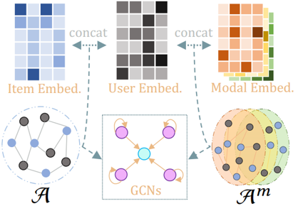

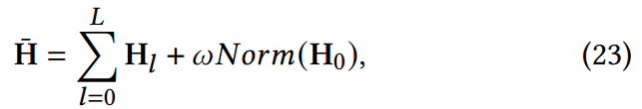
ChongqingUniversity of Technology
ATAI
AdvancedTechniqueof
Artificial Intelligence
ATAI
ChongqingUniversity _{AdvancedTechniqueof}
of Technology Artificial Intelligence
Method

Slide 11



ChongqingUniversity of Technology
ATAI
AdvancedTechniqueof
Artificial Intelligence
ATAI
ChongqingUniversity _{AdvancedTechniqueof}
of Technology Artificial Intelligence
Method

Slide 12

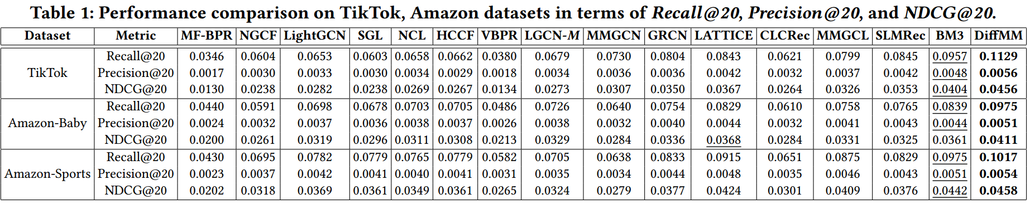
ATAI
AdvancedTechniqueof
Artificial Intelligence
ATAI
ChongqingUniversity _{AdvancedTechniqueof}
of Technology Artificial Intelligence
ChongqingUniversity of Technology
Experiments

Slide 13
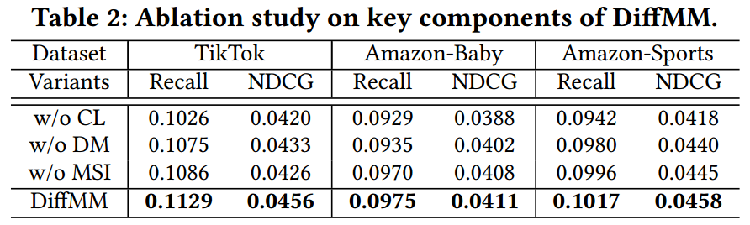
ATAI
AdvancedTechniqueof
Artificial Intelligence
ATAI
ChongqingUniversity _{AdvancedTechniqueof}
of Technology Artificial Intelligence
ChongqingUniversity of Technology
Experiments

Slide 14
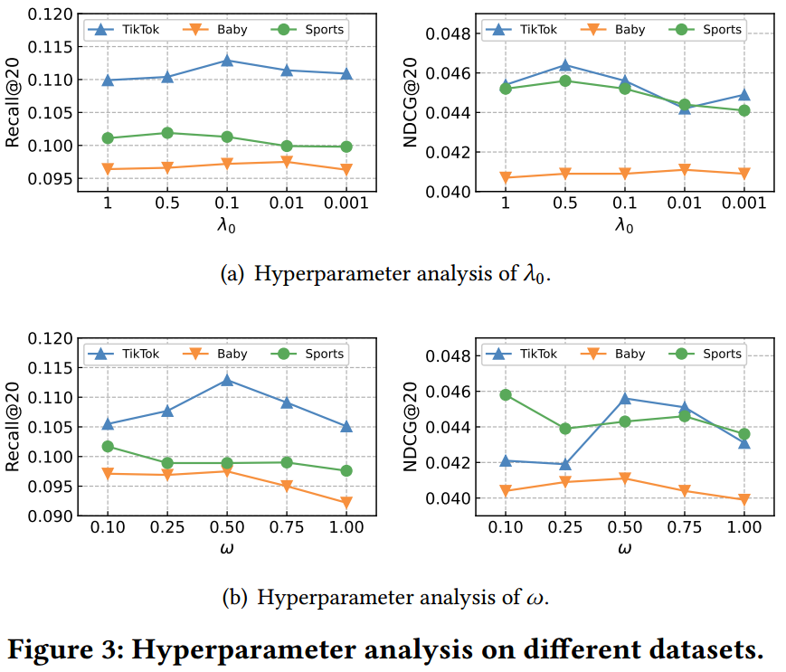
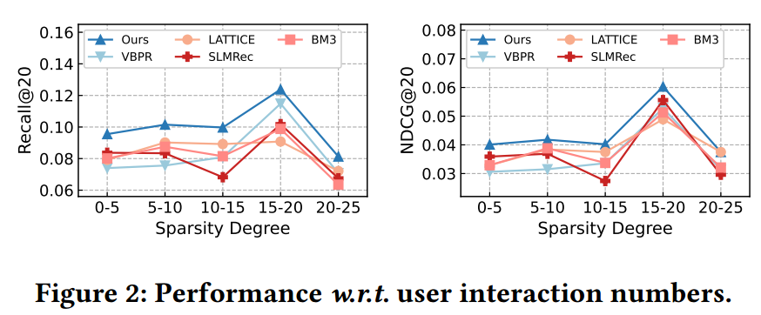
ATAI
AdvancedTechniqueof
Artificial Intelligence
ATAI
ChongqingUniversity _{AdvancedTechniqueof}
of Technology Artificial Intelligence
ChongqingUniversity of Technology
Experiments

Slide 15
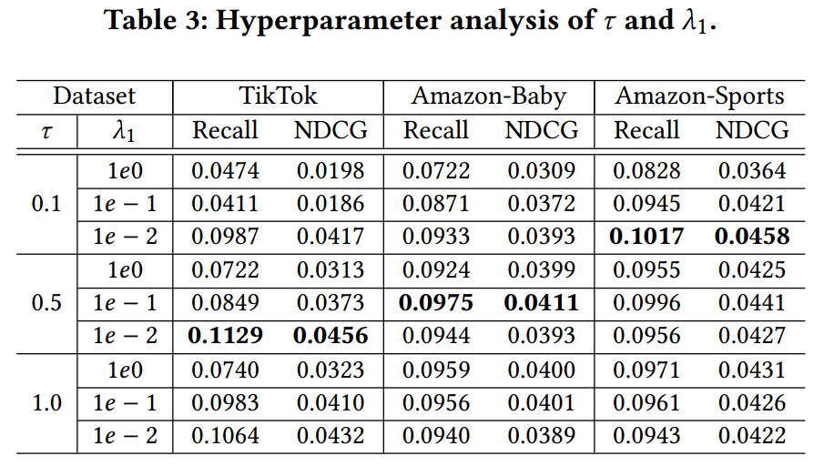
ATAI
AdvancedTechniqueof
Artificial Intelligence
ATAI
ChongqingUniversity _{AdvancedTechniqueof}
of Technology Artificial Intelligence
ChongqingUniversity of Technology
Experiments

Slide 16
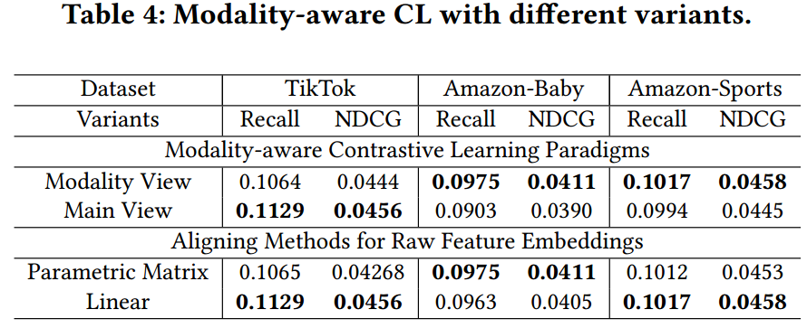
ATAI
AdvancedTechniqueof
Artificial Intelligence
ATAI
ChongqingUniversity _{AdvancedTechniqueof}
of Technology Artificial Intelligence
ChongqingUniversity of Technology
Experiments

Slide 17


ChongqingUniversity of Technology
ATAI
AdvancedTechniqueof
Artificial Intelligence
ATAI
ChongqingUniversity _{AdvancedTechniqueof}
of Technology Artificial Intelligence
Thanks!

